Slide 1


Data Science Project
P266 Resume Classification
Group 4

Slide 2







Project Workflow
Basic Data Preprocessing
Model Building
Model Deployment
Exploratory Data Analysis
Model Evaluation

Slide 3
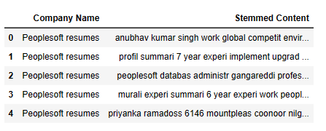
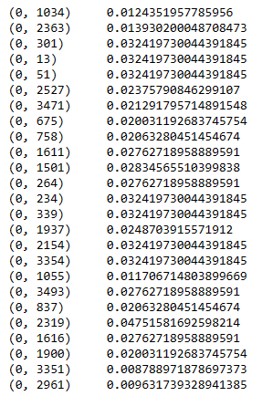
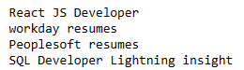

Feature Extraction
TF-IDF Vectorizer
Label Encoder

Slide 4
Model Building
Logistic Regression
Decision Tree
Random Forests
Boosting
K-Nearest Neighbors (KNN)
Support Vector Machine (SVM)
Naive Bayes
Gradient Boosting
XGBoost
LightGBM

Slide 5
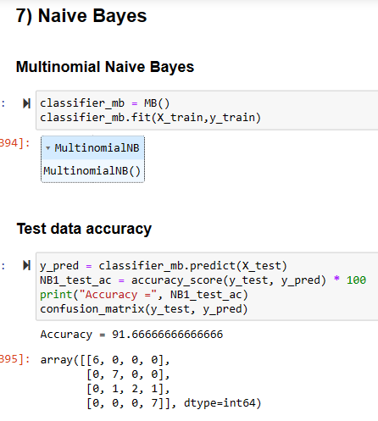
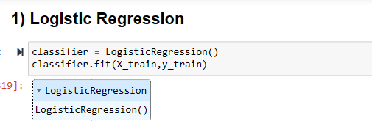
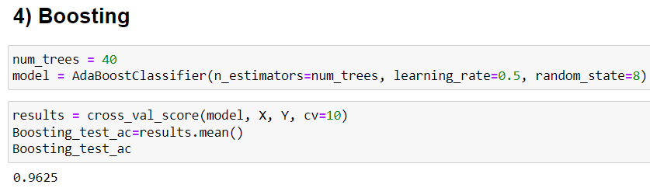
Model Building

Slide 6
Model Building
Dataset
Train-Test Split
Training Dataset
70% Data
Testing Dataset
30% Data
Accuracy
Training Data Accuracy
Testing Data Accuracy

Slide 7
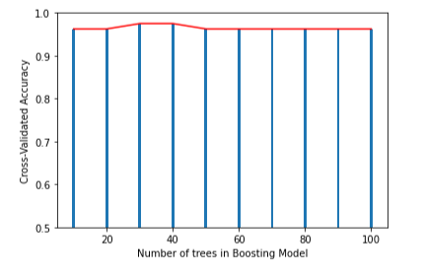
Model Building
Hyperparameter Tuning
GridSearchCV
Visualized Cross Validation Results

Slide 8

Model Evaluation
Sr. No. | Model | Model Accuracy (%)
0 | Logistic Regression | 87.50
1 | Decision Tree | 91.67
2 | Random Forests | 96.07
3 | Boosting | 96.25
4 | K-Nearest Neighbours (KNN) | 95.83
5 | Support Vector Machine (SVM) | 95.83
6 | Naive Bayes | 91.67
7 | Gradient Boosting | 91.67
8 | XGBoost | 83.33
9 | LightGBM | 91.67

